Slide 1
Special products (i.e.: reverse mortgage)
Partner: University of Malaga

Slide 2
Objectives & Goals
At the end of this module you will be able to:
Understanding how reverse mortgages work.
Understanding how structured deposits work.

Slide 3
Index
1.- What is a reverse mortgage?
2.- Ways of repayment of reverse mortgages.
3.- What are foreign currency bank accounts?
4.- What is a linked deposit?
5.- Mixed savings-investment deposits.
6.- What to consider when taking out a structured deposit.
7.- Example of linked deposit.

Slide 4
1. What is a reverse mortgage?
This is a loan secured by a mortgage on the habitual residence, granted in one lump sum or through periodic payments, to a person who must be over a certain age - from 65 years old - or prove a degree of disability (equal to or greater than 33%) or dependence (severe or great dependence), and cannot be repaid until the time of death.
In this operation (reverse mortgage), the client does not go to the Bank to request a loan to acquire a home, which he will then guarantee by mortgaging it, but rather he takes the home under his arm, offering it as security for the loan. Moreover, without losing the ownership of the property, which can continue to be used until the client's death.

Slide 5
1. What is a reverse mortgage?
The purpose of this loan is to provide income until the death of the homeowner.
The maximum amount granted in this type of loan is a certain percentage of the appraised value at the time of contracting the operation. This amount can be drawn down all at once, but will normally be paid periodically (usually in the form of a monthly income). The amount of this rent to be received depends on several factors:
Value of the house.
Age of the person taking out the loan and his/her spouse.
The choice between receiving the rent for a fixed period or for life.

Slide 6
1. What is a reverse mortgage?
As an example, a home valued at 100,000 euros will allow you to receive 10,000 euros a year for 10 years. However, in the event that the money granted in a loan runs out because the elderly person has exceeded the life expectancy the bank was working with, most financial institutions allow you to take out deferred life annuity insurance that will guarantee that the elderly person can continue to receive their monthly income until they die.
The reverse mortgage can be an additional complement to other income that the holder may be receiving, such as a pension or other funds, and has tax advantages. Moreover, as it is a loan, this additional monthly income is not subject to Personal Income Tax (PIT).
Things change when you receive the money from the annuity insurance, if this is the case, as this capital does pay tax. However, the amount to be paid will be a small percentage of the amount received, thanks to the tax advantages available.

Slide 7
2. Ways of repayment of reverse mortgages.
Contrary to a conventional mortgage, where it is normal for the debtor to fulfil his obligation to repay the loan in instalments on a regular basis, the loan will be repaid upon the debtor's death.
That is, the financial institution cannot demand repayment of the accumulated debt until the holder or the last of the beneficiaries of this loan dies, as established in the contract. However, if desired, the loan can be cancelled early.

Slide 8
2. Ways of repayment of reverse mortgages.
On the death of the owner, the heirs are entitled to both the ownership of the property and the debt accumulated with the financial institution, with two options:
Keep the house: to do so, they must pay off the debt with the institution, repaying the money they have borrowed. If they do not have the equity to do so, they can finance themselves by taking out a normal mortgage on the home, for the amount of the debt.
Sell the house: in this case the amount of the sale is used to pay off the debt incurred by the holders of the reverse mortgage. If the amount is not sufficient to satisfy the accumulated debt, the institution can request the sale of other assets of the inheritance.

Slide 9
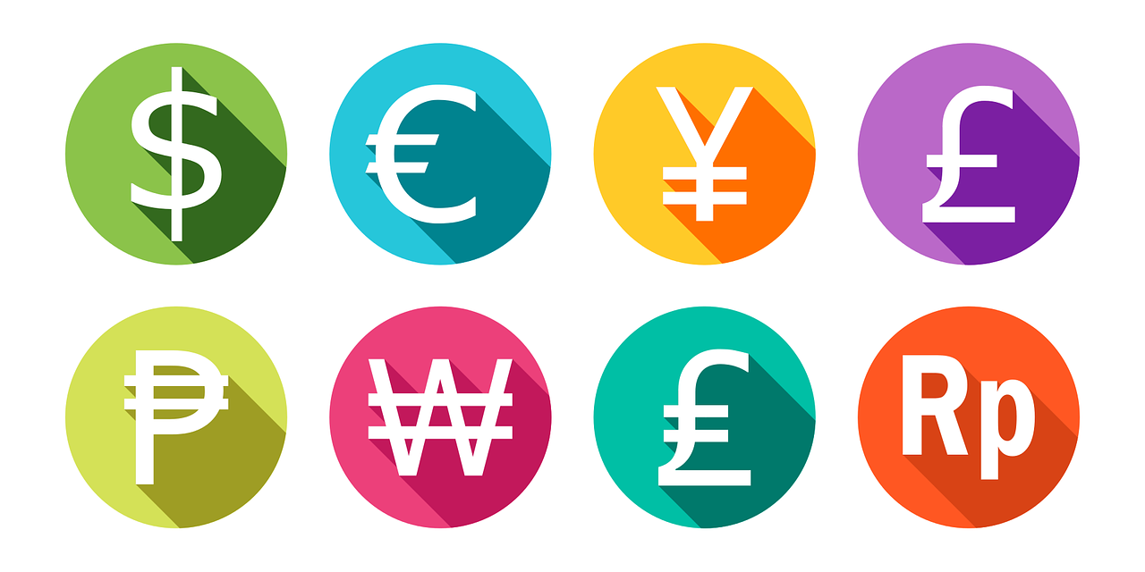
3. What are foreign currency bank accounts?
A foreign currency bank account is an account that operates in a currency different from the euro. In other words, if we have a dollar account, we can hold dollars in the same way as we hold euros in a normal account. It is important to clarify that in order to deposit or transfer money, we will have to do so in dollars.
And how can we deposit dollars if we have euros? The bank will exchange them at the current market exchange rate, although they will normally charge a commission.
The commissions are usually higher than those of a euro account, but it all depends on how closely you are linked to the bank.

Slide 10
3. What are foreign currency bank accounts?
It should be kept in mind that this financial product is considered to have a very high risk profile given the uncertainty of exchange rate movements.
For example, we open a deposit in foreign currency and exchange it from euros to dollars, for which we receive the agreed remuneration, which is higher than in euros. When we want to get our money back in euros, i.e. change the dollars to euros, depending on the exchange rate at that time, we can earn or lose money.

Slide 11
4. What is a linked deposit?
The linked deposits are investment banking products: you deposit capital in the bank and in exchange it offers a profitability. However, in this type of deposit, the final remuneration will always be linked to the evolution of a stock market share, an index (e.g. Ibex35, Eurostoxx, etc.), an interest rate (e.g. Euribor) or an exchange rate (e.g. euro-dollar).
Therefore, contrary to fixed-term deposits, a variable return will be obtained. If the performance of the index is favourable, a higher return is obtained compared to an ordinary deposit; similarly, if the performance of the index is unfavourable, the return could be zero. In short, greater risk and uncertainty are assumed.

Slide 12
5. Mixed savings-investment deposits.
Mixed or dual deposits are a combination of fixed-term deposits and index-linked deposits. In this case, part of the capital is placed in a fixed-term deposit for a certain period of time and at a certain interest rate.
The remainder of the capital is placed in a linked deposit for a different period of time and the interest on this part of the deposit is conditional on the performance of its benchmark index.

Slide 13
6. What to consider when taking out a linked deposit?
Return of capital guarantee: check whether 100% of the capital is guaranteed to be returned at the maturity of the deposit.
Is there a guaranteed maximum or minimum profitability?: the profitability will depend on the performance of the values to which the deposit is indexed. Usually, a minimum profitability is guaranteed in case the performance of the index or benchmark securities is not as expected. Sometimes, however, the minimum is 0%, i.e. no interest is earned. If this is not the case, bear in mind that losses could be incurred.

Slide 14
6. What to consider when taking out a linked deposit?
Is it possible to cancel early?: most of them do not allow early cancellation, so it is necessary to foresee if you are going to need the money before maturity, as you will not be able to redeem it. There are exceptions and in some cases they can be cancelled, but you have to pay an early cancellation fee, which can be very high.
Taxation of structured deposits: income from structured deposits is subject to tax, as is income from fixed-term deposits, which is taxed in the same way.

Slide 15
6. What to consider when taking out a linked deposit?
The APR is not the same as the coupon: it is necessary to emphasise the difference between the APR and the coupon (periodic interest). Most banks offer their bundled and index-linked deposits by emphasising the attractive return on their coupons, but the coupon is only the final return on the product, i.e. the total percentage that can be earned on the capital invested.
On the contrary, the APR, which will usually be lower, is the net annual return and, at the same time, the reference value that will serve as a comparison between different deposits

Slide 16
7. Example of linked deposit.
Let us imagine that a customer goes to bank "X" and takes out a deposit linked to the shares of two listed companies with a term of 12 months. According to the product's prospectus, the final remuneration of the deposit will be variable and will depend on the performance of the assets according to the following:
If at the end of the deposit, the price of both shares is equal to or higher than the initial price, the institution will pay a coupon of, for example, 3% on the nominal value of the deposit. In other words, the customer will earn 3% gross on the amount invested. It is important to note whether the return is expressed as a coupon (total interest), annual NIR or APR.
If, on the other hand, the final price of the shares is lower than the initial price, the institution will pay a coupon of 1%, although sometimes structured deposits may have a minimum return of 0%, i.e. if the assets do not perform well, the remuneration may end up being zero.

Slide 17
7. Example of linked deposit.
In view of the above, the customer decides to invest 10,000 euros, remember that the term is 12 months, the capital is guaranteed and the return can be either 3% or 1%. After 12 months, the two shares have increased in value: in this case, the customer will earn 300 euros gross in interest, to which 19% tax has to be deducted, and the bank will reimburse the 10,000 euros.
It could also happen that one or both shares lose value. In that case, the gross interest would be €100 and you would also get back the full amount invested.

Slide 18
Summing up
Reverse mortgage
Mixed deposit
The purpose of this loan is to provide income until the death of the homeowner.
Mixed or dual deposits are a combination of fixed-term deposits and index-linked deposits.
Linked deposit
Foreign currency account
The final remuneration will always be linked to the evolution of a stock market share, an index, an interest rate or an exchange rate.
An account that operates in a currency different from the euro.

Slide 19
Thank you!
Partner: University of Malaga

