Slide 1
Economic Indicators
Partner: University of Malaga

Slide 2
Objectives & Goals
At the end of this module you will be able to:
Knowing the concept of Gross Domestic Product.
Understanding inflation and deflation.
Understanding the concept of exchange rates and their usefulness.
Knowing how to analyse the labour market.

Slide 3
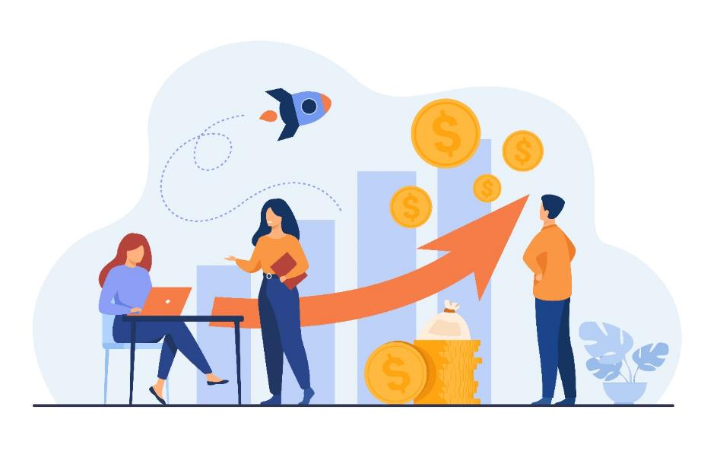
Index
1.- What is an economic indicator?
2.- What is Gross Domestic Product (GDP) and what is it for?
3.- What is inflation and how is it measured?
4.- Causes of inflation. Advantages and disadvantages.
5.- What is the exchange rate and why is it important?
6.- What is the labour market and how dows it work?

Slide 4
1. What is an economic indicator?
Economic indicators are statistical data that provide information on the state of the economy, showing us, in addition to its main characteristics, how it is changing over time, which makes it possible to make projections and comparisons between different periods and territories.
Economists use these indicators to measure the past and present state of an economy and to anticipate the future. In short, to analyse the economy and see how it is evolving.
Some of the most relevant economic indicators are:
Gross Domestic Product (GDP)
Inflation
Exchange rate
Labour market

Slide 5
2. What is Gross Domestic Product (GDP) and what is it for?
Gross Domestic Product (GDP) is the monetary value of goods –from foodstuffs, vehicles, machinery or textiles– and services –such as health, education, etc.– produced at the national level during a given period of time. It does not matter whether the public or private organisations producing them are local or foreign, the requirement is that the final good or service is carried out in the country to be analysed. GDP will reflect the monetary value of everything that reaches the final consumer.

Slide 6
2. What is Gross Domestic Product (GDP) and what is it for?
For example, to manufacture a vehicle, components such as wheels are needed. To calculate the total production value, we do not take into account the value of the wheels separately, but only the value of the complete vehicle, in order to avoid double counting.
To avoid such inconveniences and inconsistencies, only final goods and services are included in GDP, not intermediate goods and services.

Slide 7
2. What is Gross Domestic Product (GDP) and what is it for?
What is GDP for?
The absolute value of GDP is used to compare the economic size of countries, free trade areas or continents. Moreover, its evolution is crucial for a market to compare with itself over time: the annual rate of change of Gross Domestic Product compared to the previous year is the main indicator of the health of an economy.

Slide 8
2. What is Gross Domestic Product (GDP) and what is it for?
An increase in GDP reflects an increase in economic activity. If economic activity booms, it means that unemployment tends to fall and per capita income rises. This in turn leads to economic growth, as citizens and businesses will be more inclined to spend rather than save. Moreover, following an increase in GDP, government tax revenues tend to rise, as the government collects more taxes and can therefore allocate these amounts to expenditure items.
Quarter-on-quarter changes in GDP are also very relevant: in Europe, a country enters a technical recession when its GDP falls for two consecutive quarters compared to the previous quarter.

Slide 9
3. What is inflation and how is it measured?
Inflation is the generalised and sustained increase in the prices of goods and services in a country over a given period of time. It results in a loss of purchasing power, as the value of the currency depreciates.
That is, inflation makes your money worth less and less. Therefore, tomorrow, you will be able to buy fewer things than today with the same money.

Slide 10
3. What is inflation and how is it measured?
The indicator used to measure inflation in a country is the Consumer Price Index (CPI). This index takes into account the monthly variation in the prices of goods and services consumed by households. It is compiled on the basis of the prices of a standard shopping basket for an average household. This basket includes items from different categories, such as food, beverages, clothing and footwear, housing, household goods, medicine, transport, communications, leisure and culture, hotels, cafes and restaurants, education, and other goods and services. Its composition is regularly reviewed to add new products whose consumption is becoming significant, or to exclude others that are no longer significant.

Slide 11
3. What is inflation and how is it measured?
This index tells us what happens to prices (whether they go up or down) from one month to the next, and does not indicate the prices themselves. In other words, it does not show the price of consumer products, but rather the increase or decrease in prices.
If prices move upwards, it is said that there is inflation (increase in the prices of goods and services). But it should be borne in mind that inflation will always be referenced within a certain period (e.g. it does not mean that if inflation falls, prices will fall, since with lower inflation prices continue to rise, but at a slower rate than in the past). If prices, on the contrary, move downwards, it is said that there is deflation (decrease in prices of goods and services).

Slide 12
3. What is inflation and how is it measured?
The importance of the CPI is that it measures the change in our purchasing power. If prices go up and our incomes go up less or remain constant, we will be able to buy fewer goods and services, so we are said to lose purchasing power: we are poorer, even if we earn the same amount. In the same way, if a worker's salary is increased in the same proportion as the CPI, his or her purchasing power is maintained, i.e. the worker will be able to buy exactly the same amount of goods and services with his or her new salary, even if the salary has been increased

Slide 13
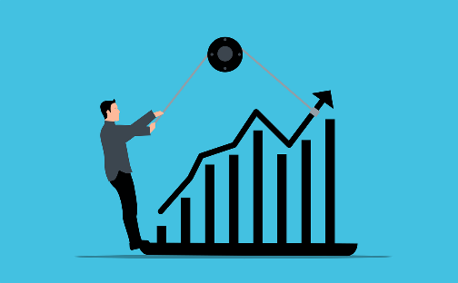
4. Causes of inflation. Advantages and disadvantages.
Inflation can be caused by a number of factors, such as the following:
Demand-pull inflation: This occurs when overall demand increases and the supply side of the productive sector is unable to keep up with this demand, so prices rise. For example, if only one million of a particular model of mobile phone could be produced and demand reached two million, the price to be paid for this model would be higher than if, on the contrary, the number demanded was reached. Or when a brand of clothing becomes fashionable, its price tends to rise.

Slide 14
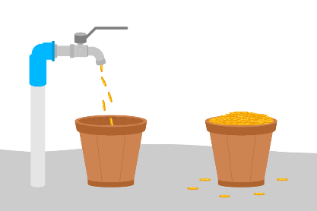
4. Causes of inflation. Advantages and disadvantages.
Cost-push inflation: It occurs when production costs increase, either because of higher prices for raw materials, higher labour costs or higher taxes, which causes producers to raise the final price of the product or service to compensate for this increase. For example, if the price of a barrel of oil rises, so does the price of a litre of fuel at the petrol station.
Monetary inflation: This type of inflation is neither supply nor demand driven. It occurs when the money supply or money in circulation simply increases (the amount of money being produced increases). This means that there is more money in circulation to spend on goods and services, which in turn generates an increase in demand that may not be affordable for suppliers, leading to an increase in their price.

Slide 15
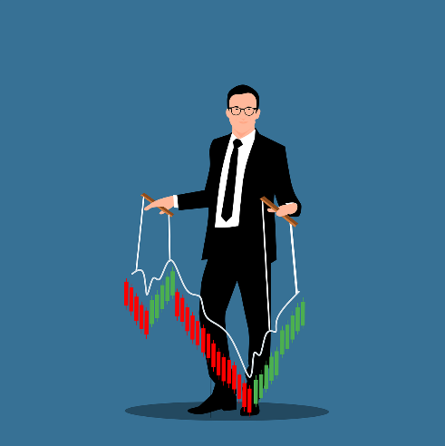
4. Causes of inflation. Advantages and disadvantages.
Built-in inflation: It arises from producers' expectations that prices will rise in the future and they seek to anticipate them by raising prices first, causing their predictions to be fulfilled in the end because prices have risen.
The effects of inflation in an economy can be both positive and negative.

Slide 16
4. Causes of inflation. Advantages and disadvantages.
On the one hand, the positive effects include wage increases based on rising prices, thereby maintaining people's purchasing power, promoting consumption growth and reducing the value of debts.
On the other hand, the negative effects of inflation include the loss of purchasing power, when price increases are not accompanied by wage increases, as well as a decrease in savings and investment, resulting from the loss of the value of money.
The monetary policy implemented by the European Central Bank stipulates that it is important that inflation in the euro area should not exceed 2%.

Slide 17
5. What is the exchange rate and why is it important?
The exchange rate is the ratio between the value of one currency and another, i.e. it tells us how many units of one currency are needed to obtain one unit of another.
This concept, the exchange rate, is important because by allowing the conversion of one country's currency into another country's currency, it facilitates international trade in goods and services and the transfer of funds between countries. It also allows the comparison of prices of similar products in different countries.

Slide 18
5. What is the exchange rate and why is it important?
We will explain with an example how the exchange rate is calculated in the foreign exchange market:
We take as a reference the exchange rate between the euro and the dollar (EUR/USD). The numerator currency is always the base currency (in this case the euro), while the denominator currency is the counter or quote currency (the dollar in our example).
Let's assume that the exchange rate between these currencies is: EUR/USD = 1.0430
What does this figure tell us? It means that 1 € is worth 1.0430 $ (the dollars we would receive in exchange for 1 euro) or, in other words, by calculating the inverse (1/1.0430 = 0.9587), the dollar is worth 0.9587 €, i.e. for 1 $ we would receive 0.9587 €.

Slide 19
6. What is the labour market and how does it work?
The total supply and demand for employment in a country, a city or a specific region is called the labour market. Its balance determines the level of employment and unemployment in that region.
In the labour market, the supply of labour is made by individuals and the demand by companies. From the balance between the supply and demand for labour comes the price and quantity, which in the labour market is called "wages" and the quantity exchanged is called "labour”.
When labour supply is lower and demand is higher, wages will tend to rise. Conversely, the higher the supply and the lower the demand, the lower wages will tend to fall.

Slide 20
6. What is the labour market and how does it work?
A number of variables are relevant for the analysis and understanding of the labour market situation:
Total population: resident population.
Working-age population: usually includes persons aged 16 years and over.
Active population: comprises all persons of working age who are employed or in the process of seeking employment.
Employed population: persons in employment or self-employment.
Unemployed population: active unemployed persons.

Slide 21
6. What is the labour market and how does it work?
TOTAL POPULATION
Labour supply: equals the active population.
Labour demand: equals existing employment plus unfilled vacancies.
Activity rate: total active over the working-age population.
Employment rate: total employed over the working age population.
Unemployment rate: number of unemployed over the total number of active people.
WORKING AGE POPULATION (>16 YEARS)
NON-WORKING AGE POPULATION (<16 YEARS)
ACTIVE POPULATION
INACTIVE POPULATION
WORKING POPULATION
UNEMPLOYED
PENSIONERS
EMPLOYEES
SEEKING FIRST JOB
STUDENTS
OTHER GROUPS
NON-EMPLOYEES
HAVE WORKED BEFORE

Slide 22
6. What is the labour market and how does it work?
Example: The unemployment rate is asked to be calculated from the following data.
 | Thousands of people
Total population | 8,421
Working-age population | 6,799
Active population | 4,025
Inactive population | 2,774
Unemployed population | 1,000
The unemployment rate is calculated by dividing the number of unemployed by the total number of active people:
Unemployment rate = Unemployed/Active population = 1,000/4,025 = 24.84%

Slide 23
Summing up
Gross Domestic Product
Exchange rate
GDP is the monetary value of goods and services produced at the national level during a given period of time.
The exchange rate is the ratio between the value of one currency and another, i.e. it tells us how many units of one currency are needed to obtain one unit of another.
Inflation
Labour market
Inflation is the generalised and sustained increase in the prices of goods and services in a country over a given period of time.
The total supply and demand for employment in a country, a city or a specific region is called the labour market.

Slide 24
Thank you!
Partner: University of Malaga

